Slide 1


Unsupervised ML Classification Capstone Project
Book Recommendation System

Slide 2
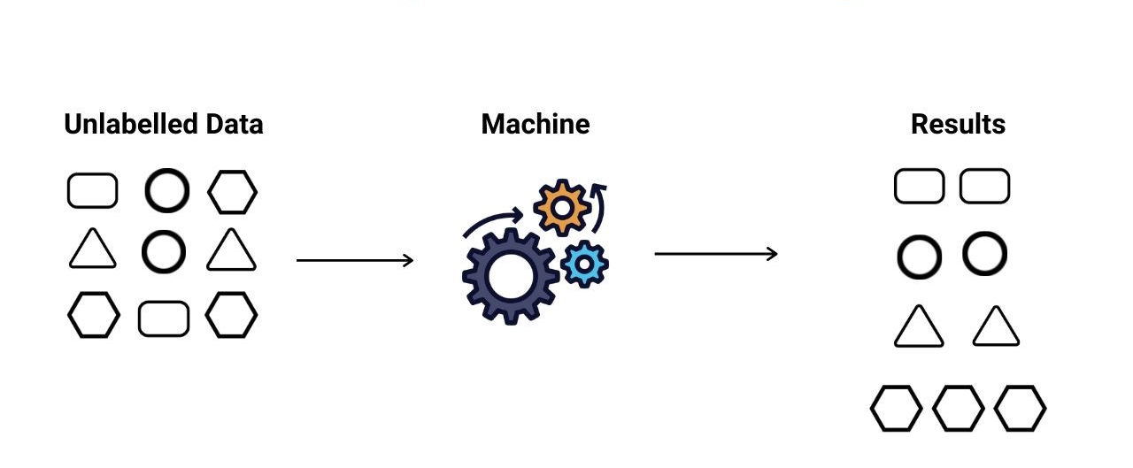
Unsupervised learning
Unsupervised machine learning, uses machine learning algorithms to analyze and cluster unlabeled datasets. These algorithms discover hidden patterns or data groupings without the need for human intervention. Its ability to discover similarities and differences in information make it the ideal solution for exploratory data analysis, cross-selling strategies, customer segmentation, and image recognition.

Slide 3
Team Members:
Kunal Gawande
Chinmay Rojatkar
Deepali Mahajan
Bipasha Zade
Nikhil Aggarwal

Slide 4


Problem Statement
During the last few decades, with the rise of YouTube, Amazon, Netflix, and many other such web services, recommender systems have become much more important in our lives in terms of providing highly personalized and relevant content.
The main objective is to create a recommendation system to recommend relevant books to users based on popularity and user interests

Slide 5


Problem statement
01
Data Summary
Imputing missing values
Data Cleaning
02
Analysis of different datasets
Different Recommendation Model
Content
03
Challenges
04
Conclusion
Future Scope
05

Slide 6

Data Summary
The dataset is comprised of three csv files:: User_df, Books_df, Ratings_df
Users_dataset.
● User-ID (unique for each user)
● Location (contains city, state and country separated by commas)
● Age
Shape of Dataset - (278858, 3)
Books_dataset.
● ISBN (unique for each book)
● Book-Title
● Book-Author
● Year-Of-Publication
● Publisher
Shape of Dataset - (271360, 8)
Ratings_dataset.
● User-ID
● ISBN
● Image-URL-S
● Image-URL-M
● Image-URL-L
● Book-Rating
Shape of Dataset - (1149780, 3)

Slide 7
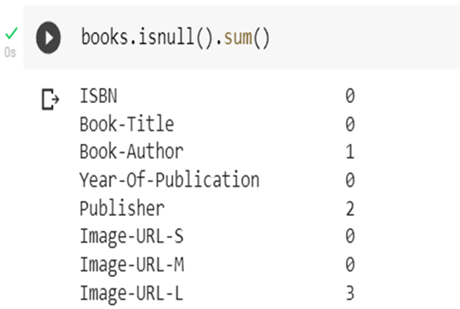
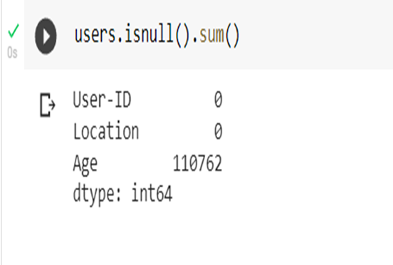
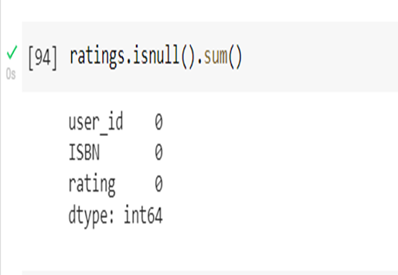
Data Preprocessing
Data Cleaning
Books_dataset
1
2
3
Users_dataset
Ratings_dataset
As we can see in the output, books.isnull().sum()
Function has return Book-Author columns 1 NaN ,Publisher columns 2 NaN and Image-URL-L columns 3NaN data are present
As we can see in the output, Users.isnull().sum()
Function has return Age columns 110762 NaN data are present
As we can see in the output, ratings.isnull().sum()
Function has Not NaN data are present

Slide 8
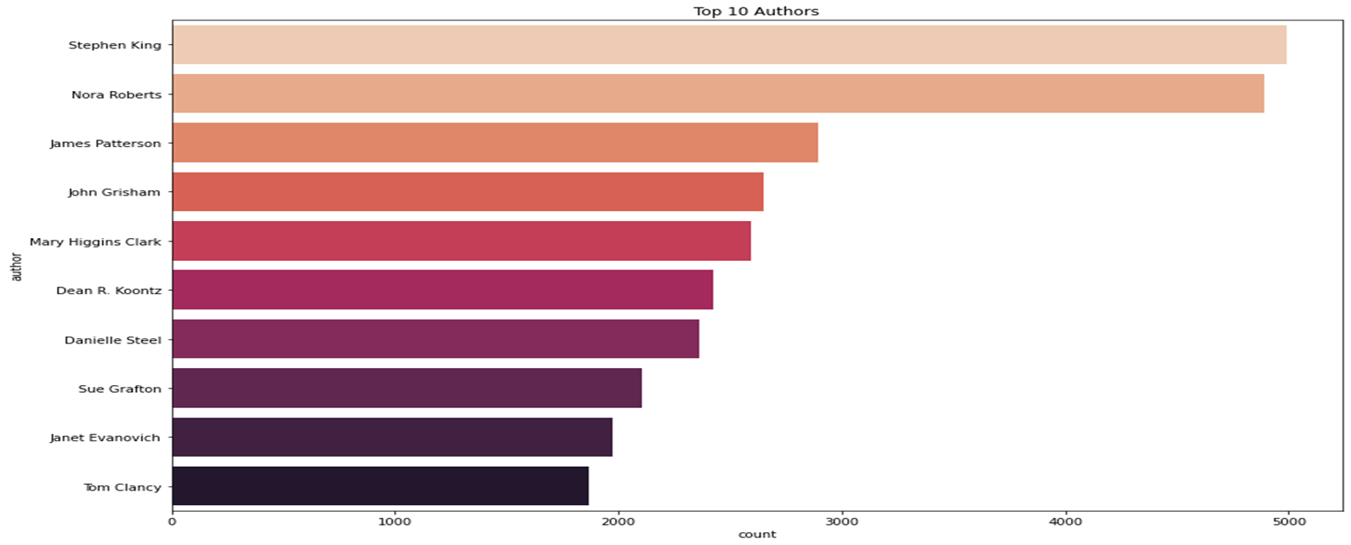
Exploratory Data Analysis (EDA)
Author Stephen King highest number of books in our given dataset
.

Slide 9
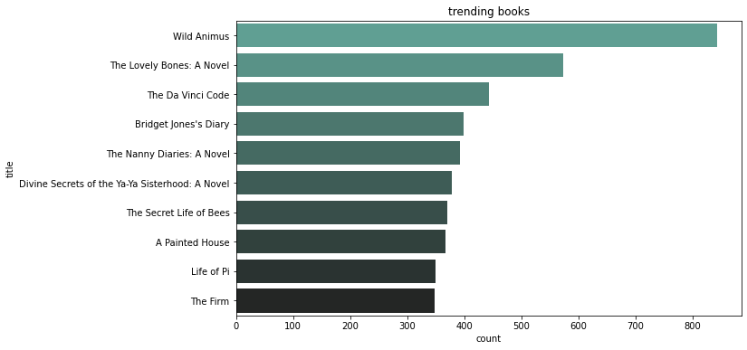
Observations from Top 10 Books
Wild Animal highest number of books in our given dataset
.

Slide 10
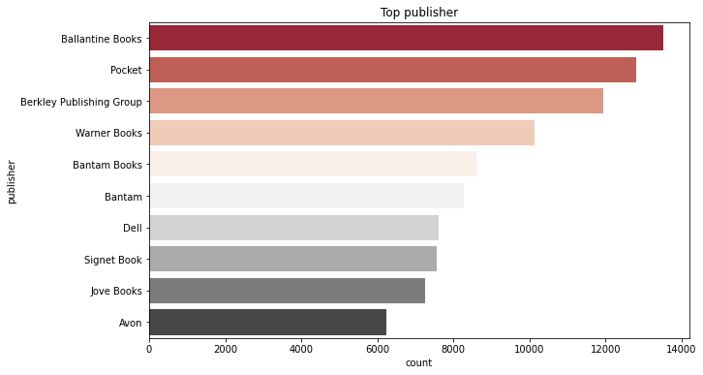
Observations from Top 10 publisher
Ballantine Books published highest number of books in our given dataset
.

Slide 11
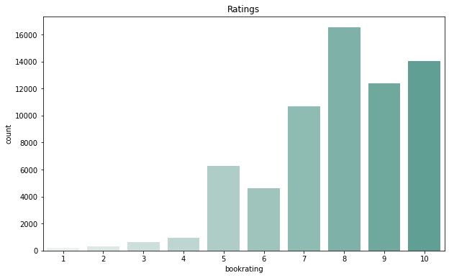
Observations from Book Ratings.
Higher ratings are more common amongst users
Rating 8 has been rated the highest number of times
.

Slide 12
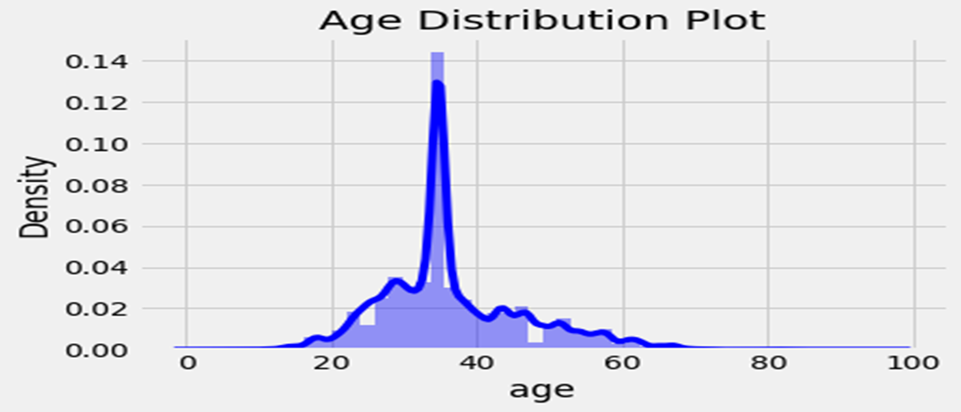
Age Distribution
The Age range distribution is right skewed
Most active readers lie in age group 20- 60
.

Slide 13
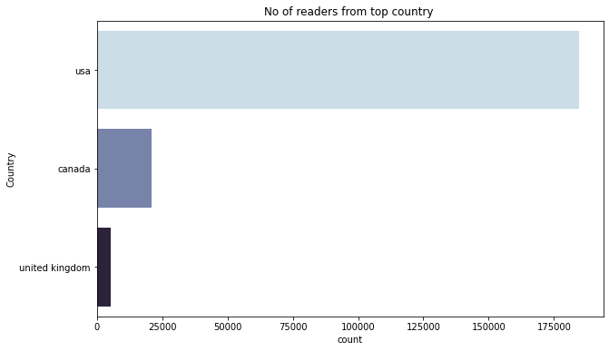
Observations from Most Active Readers.
Splitting Location column and analyzing country.
Most active readers are from USA.

Slide 14

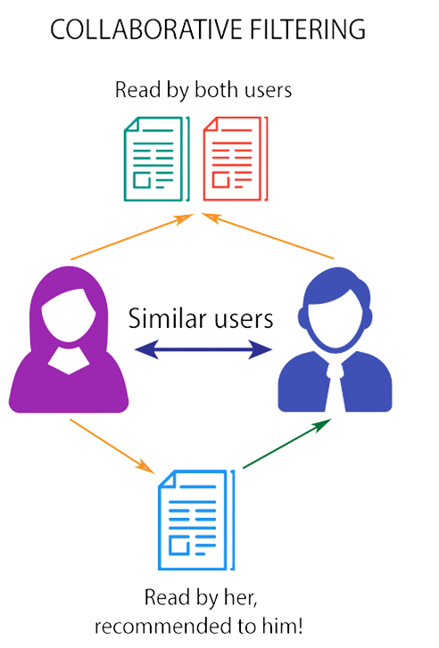
Recommendation Systems
Collaborative Filtering
Collaborative Filtering (User-Item Filtering)
Collaborative Filtering (Correlation Based)
•Collaborative Filtering (Nearest Neighbor's Based)
Collaborative filtering is a technique that can filter out items that a user might like on the basis of reactions by similar users

Slide 15
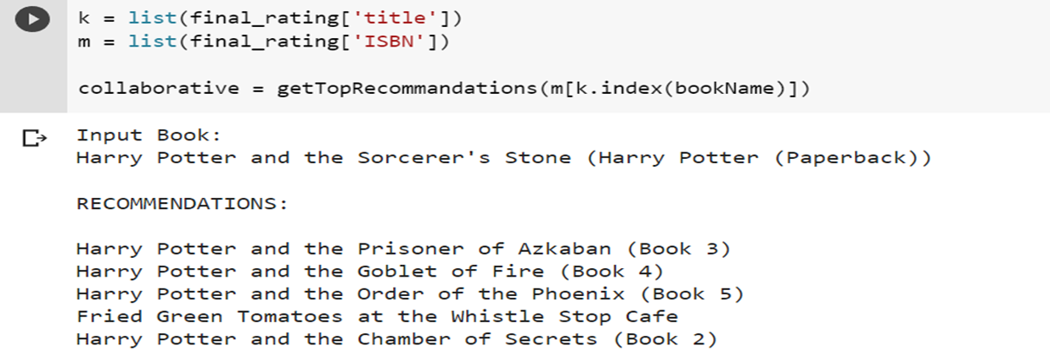
Collaborative Filtering (User-Item Filtering)

Slide 16
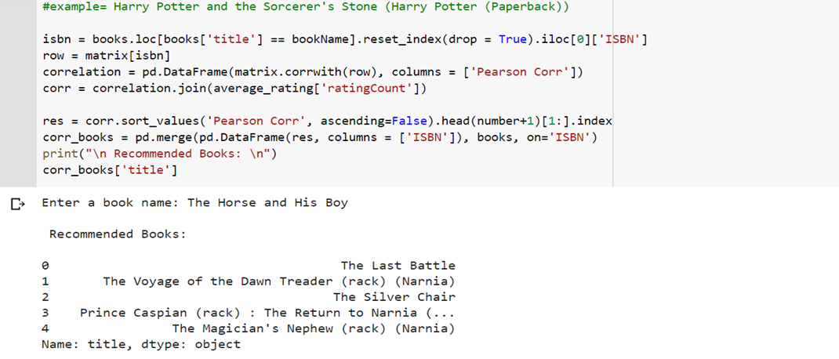
Collaborative Filtering (Correlation Based)

Slide 17
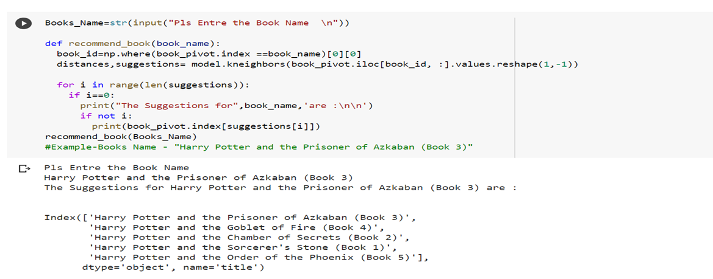
Collaborative Filtering (Nearest Neighbor's Based)

Slide 18
Future Scope
Given more information regarding the books dataset, namely features like Genre, Description etc., we could implement a content-filtering based recommendation system and compare the results with the existing collaborative-filtering based system.
We would like to explore various clustering approaches for clustering the users based on Age, Location etc., and then implement voting algorithms to recommend items to the user depending on the cluster into which it belongs.

Slide 19
Conclusion
In EDA, the Top-10 most rated books were essentially novels. Books like The Wild Animus and The Lovely Bones: A Novel .
Majority of the readers were of the age bracket 20-50 and most of them came from North American and European countries namely USA, Canada, UK.
If we look at the ratings distribution, most of the books have high ratings with maximum books being rated 8. Ratings below 5 are few in number.
Author with the most books was Stephen King, Nora Roberts and James Patterson.
A recommendation system helps an organization to create loyal customers. The recommendation system today are very powerful that they can handle the new customer too who has visited the site for the first time. They recommend the products which are currently trending or highly rated and they can also recommend the products which bring maximum profit to the company.

Slide 20


Thank you!

